Slide 1
Applied Distributed Systems CSCI B649
Team Scapsulators: Vikrant Deshpande, Shubham Mohapatra, Rutuja Jadhav
INDIANA UNIVERSITY

Slide 2
Presentation Link
https://iu.mediaspace.kaltura.com/media/t/1_7pp11gkf
*Note: Audio gets very low at 10:08 due to mic problems.

Slide 3
Introduction

Slide 4
Introduction
Our goals were:
Understand distributed architecture components, message queues, testing and deployment strategies, CICD, etc.
Build a full-stack weather analysis system that’s highly available and fault-tolerant, architected in 3 milestones.
Deploy and review an open-source project under the Apache foundation.

Slide 5
Introduction
Elevator Pitch:
Research scientists will understand how weather phenomena in a region, affect their research.
Features to view (Data Source):
Reflectivity (NEXRAD)
Spectrum width (NEXRAD)
Radial Velocity (NEXRAD)
ALBEDO (MERRA)
LWGNTICE (MERRA)

Slide 6
Experimental Testbed
Project 1

Slide 7
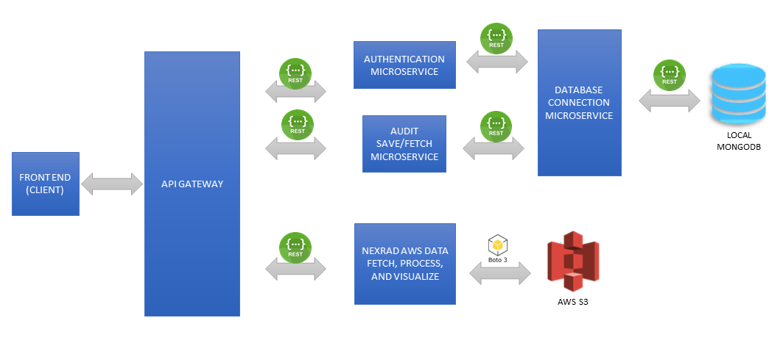
Experimental Testbed Project 1
Architecture Decisions:
6 microservices
Interservice communication in REST
Gateway handles traffic routing
User creds and audit trail in MongoDB
Single service interacts with MongoDB
Single service for NEXRAD data on S3
Circle-CI for continuous integration

Slide 8
Experimental Testbed
Project 2

Slide 9
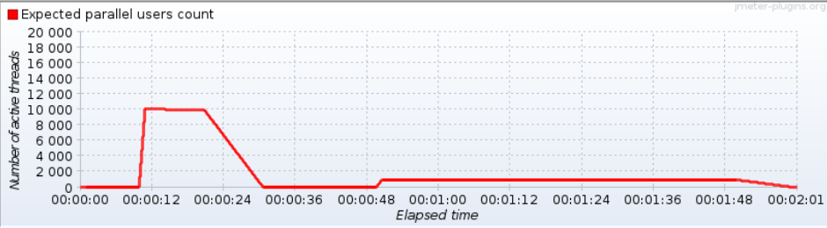
Experimental Testbed Project 2
Performance Testing:
Assess the system's maximum operating capacity.
Baseline 3 worker nodes of 16GB each assigned on Jetstream.
1, 3, 5 replica-pods spawned for each microservice using kubeadm.
Used Jmeter for both Load testing, and Spike testing.

Slide 10
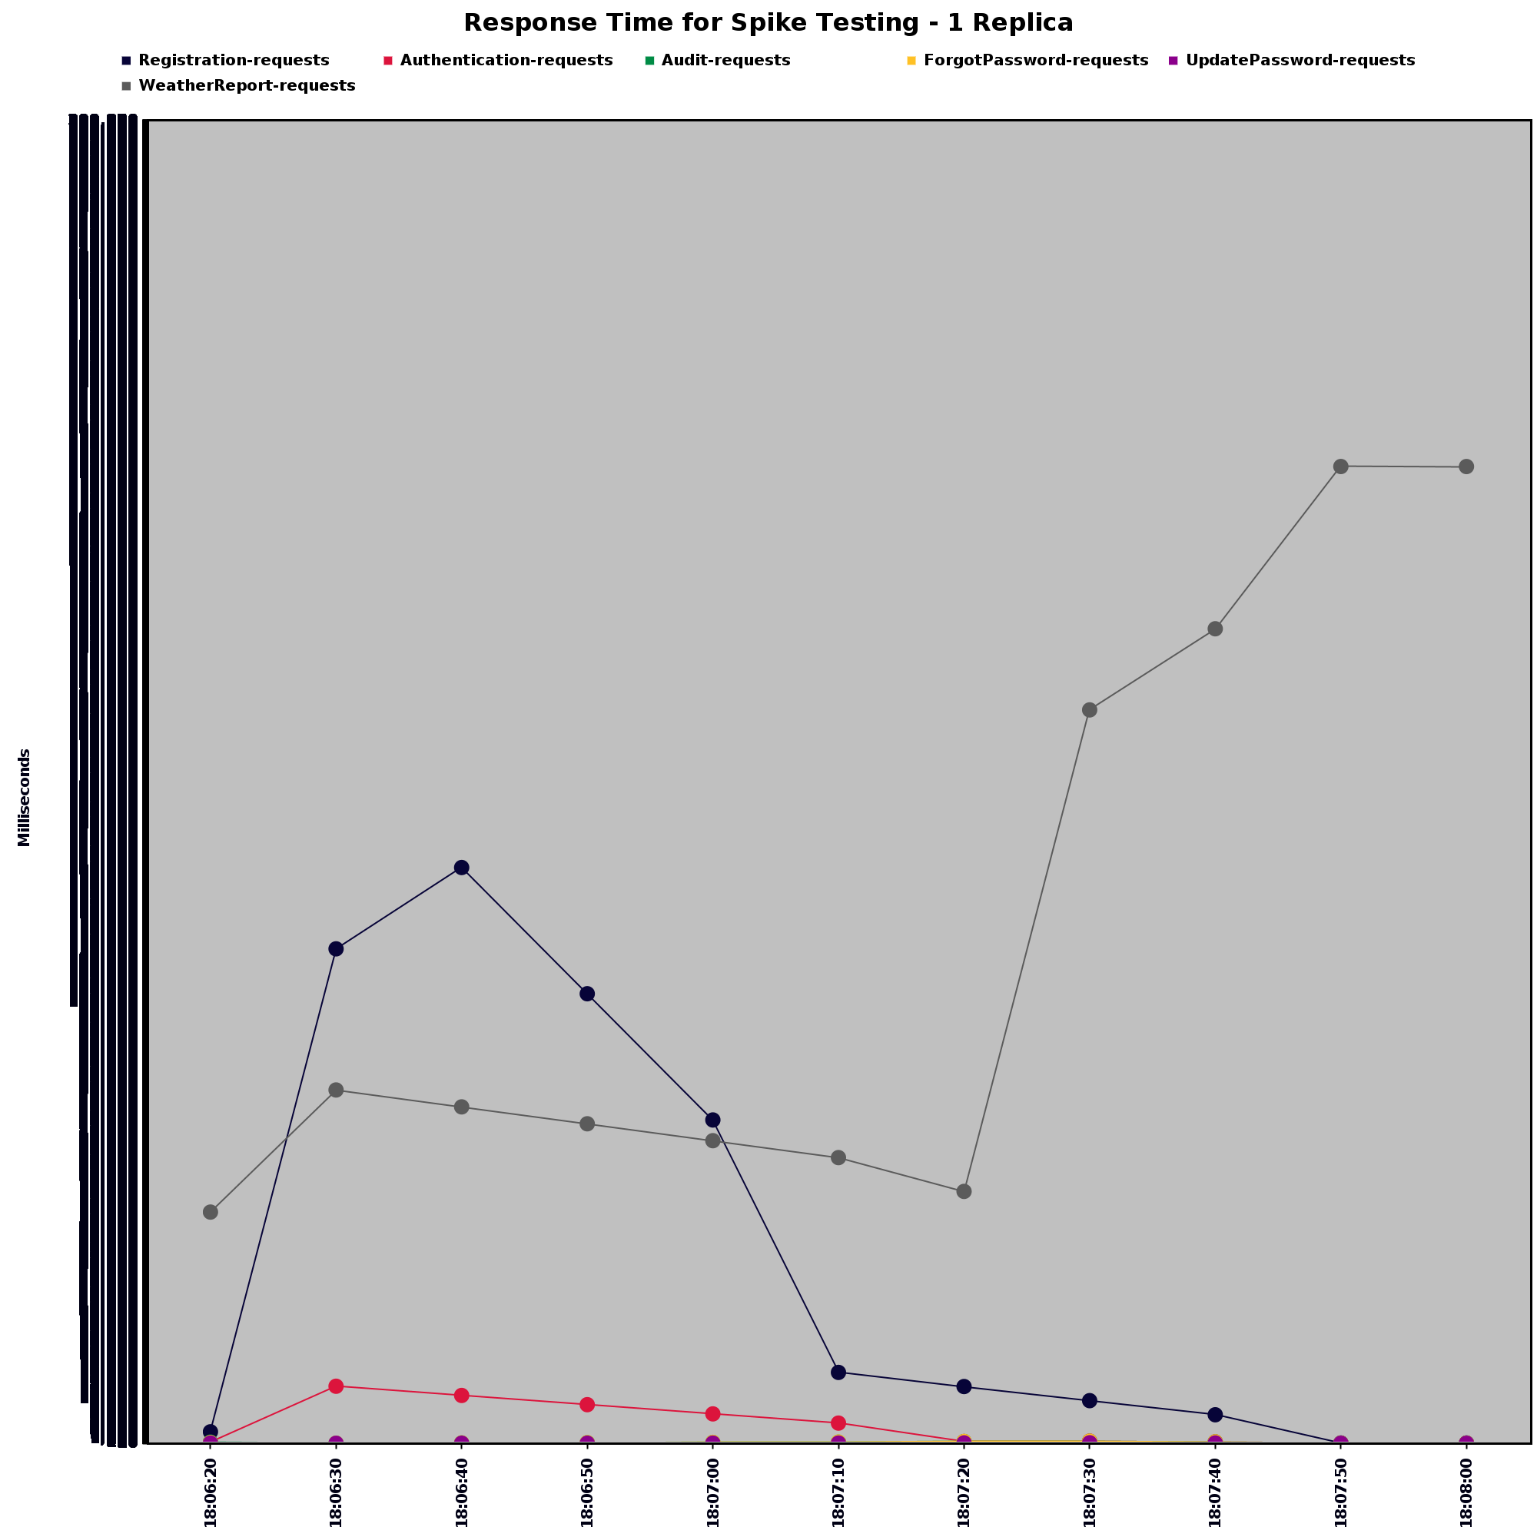
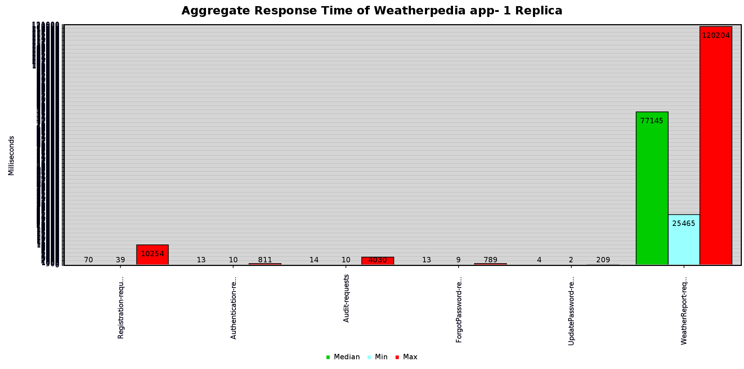
Experimental Testbed Project 2
Performance under constant load
Performance under sudden load

Slide 11
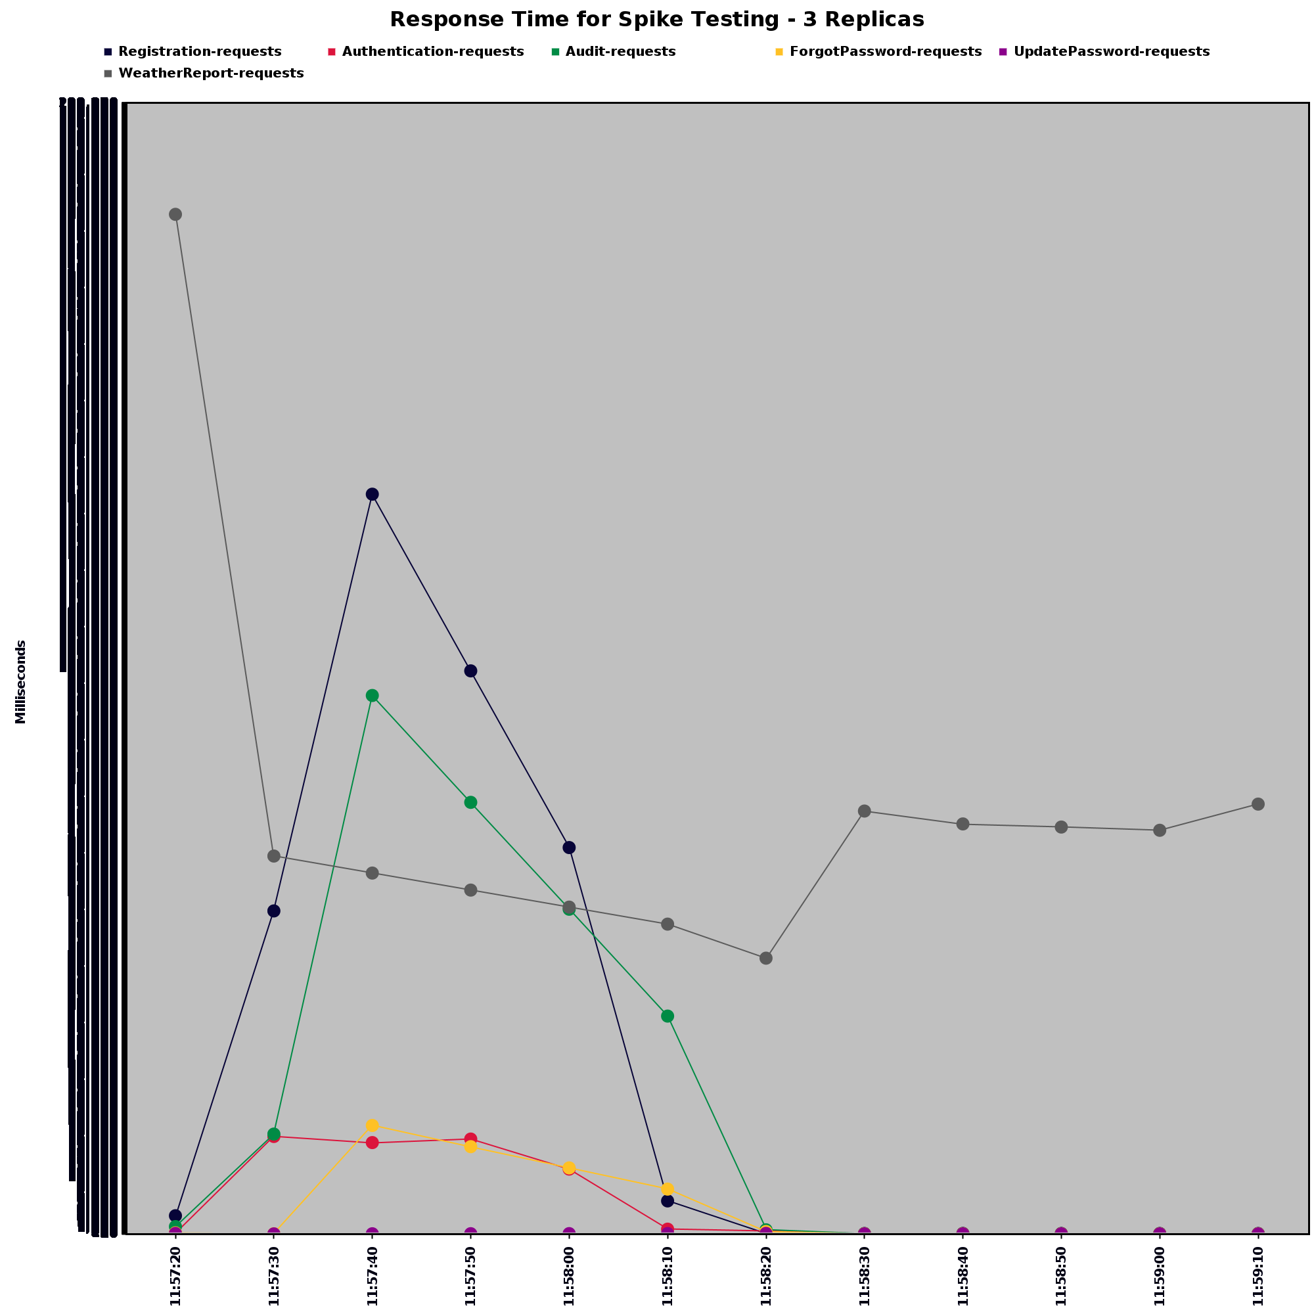
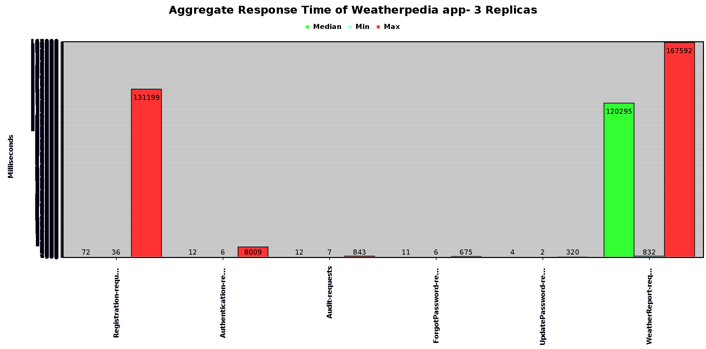
Experimental Testbed Project 2
Performance under constant load
Performance under sudden load

Slide 12
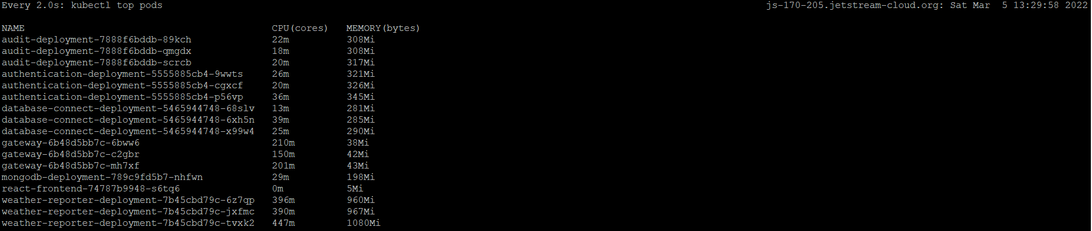
Experimental Testbed Project 2
Load Balancing in action

Slide 13
Experimental Testbed
Project 3

Slide 14
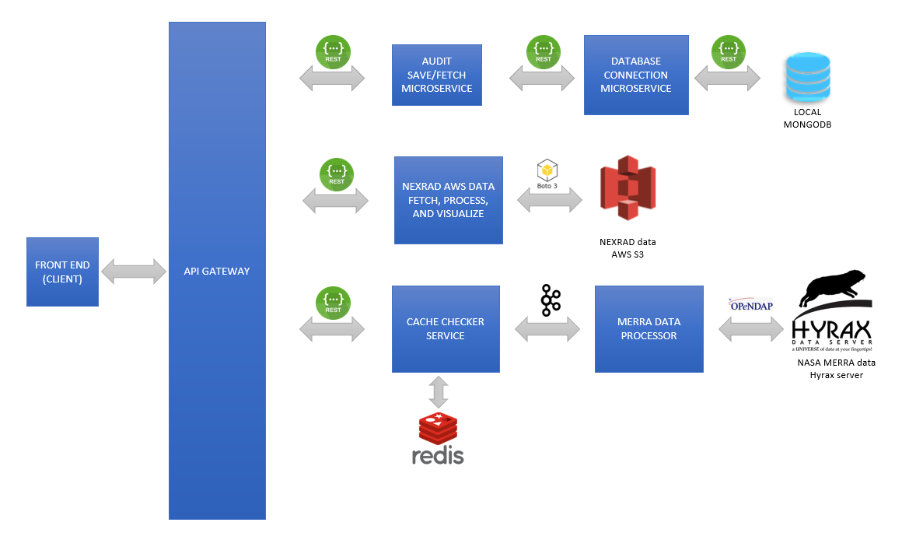
Experimental Testbed Project 3
Architecture Evolution:
7 microservices
OAUTH for session management
Kafka to stream MERRA data report
Caching of reports in Redis
User creds and audit trail in MongoDB
Circle-CI for entire CICD

Slide 15
Experimental Testbed Demo
Demonstration
http://scapsulators.ignorelist.com:30001/

Slide 16
Case Study: Custos
Project 4

Slide 17
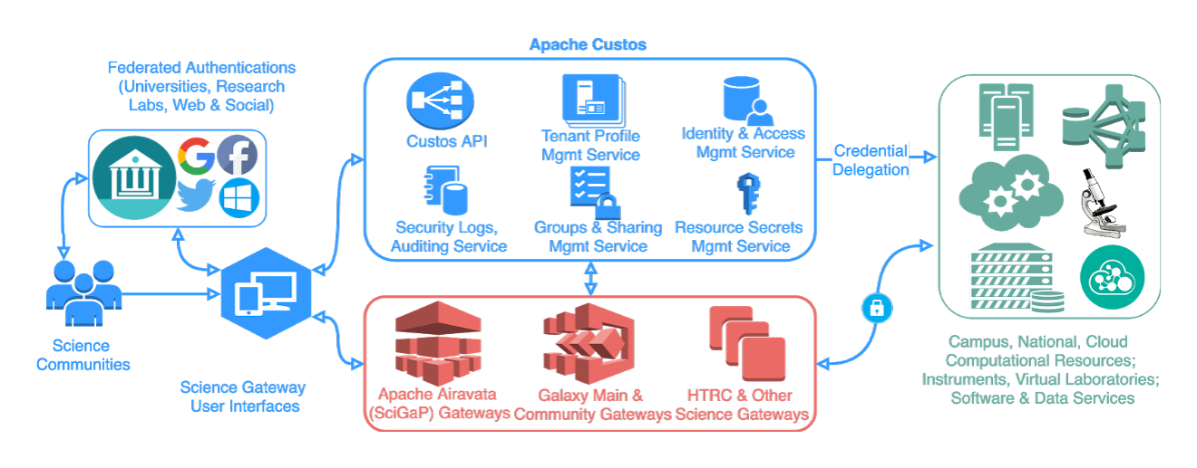
Case Study: Custos Project 4
Highlights:
Security Middleware for Gateways
Key cloak for Identity Management
Vault for Credential Management
Cert-Manager for certificates of the cluster
CI logon and federated authentication
More than 30 microservices!

Slide 18
Case Study: Custos Project 4
Open Issues identified and criticisms:
Heavy Interdependency on Custos Configuration Microservice
Key cloak and Vault are internal services which are available publicly
Finer Breakdown of microservices required
Messaging service keeps failing and restarting, should be excluded from current deployment
Documentation needs improvement

Slide 19
Thank You! ☺

